Slide 1
Milestone 3: Machine Learning Implementations
By: Albina Cako & Joshua Dalphy
Sunday January 10th, 2021

Slide 2
Objectives
Implement 2 machine learning algorithms and analyze results using appropriate evaluation and selection criteria
Implement various ensemble learning methods and analyze results using appropriate evaluation and selection criteria
Compare the performance of each model and select the best based on accuracy and runtime

Slide 3
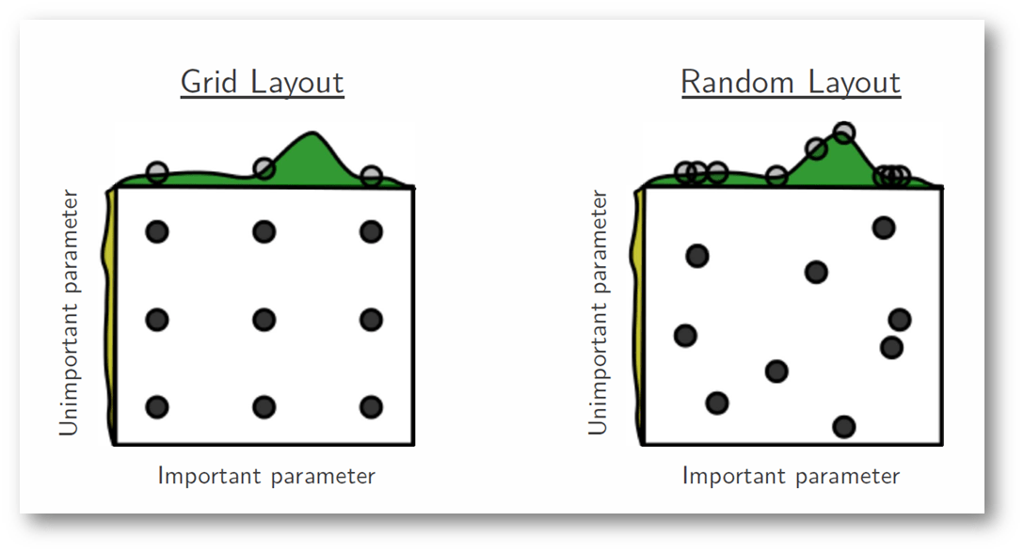
Methodology
Using the features selected from milestone 2, baseline models were produced and benchmarked (Logistic Regression, Naïve Bayes & RF).
Hyperparameter Tuning was performed where applicable using GridsearchCV and RandomizedSearchCV.
Ensemble learning methods were applied using the tuned models.
The results of each modelling methods were analyzed and compared using performance and evaluation metrics.
https://medium.com/@senapati.dipak97/grid-search-vs-random-search-d34c92946318

Slide 4
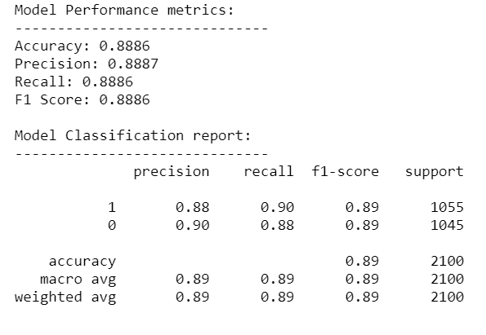
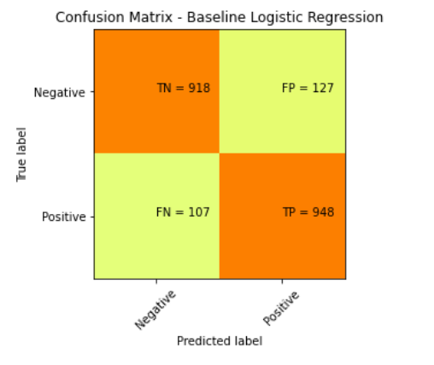
Baseline Model: Logistic Regression

Slide 5
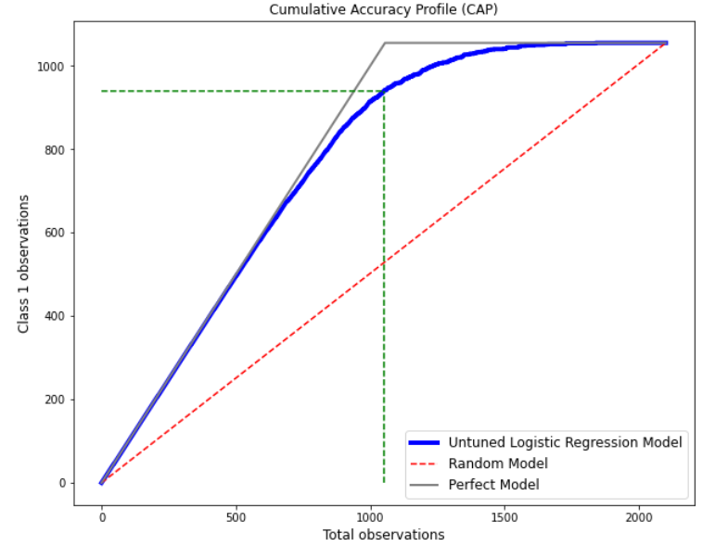
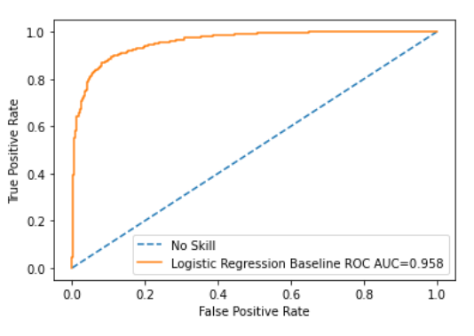
Baseline Model: Logistic Regression (cont.)
89%
50%
Guidelines for Model:
X > 90% Overfitting
80% < X < 90% Very Good Model
70% < X < 80% Good Model
60% < X < 70% Average Model
X < 60% Poor Model
Accuracy ratio (AULR/AUP): 0.915
Evaluate the Model using 50% line on the CAP Curve:
Value at 50% line is 89% which suggests that the untuned LR Model is very good
AUP = Area under the perfect model
AULR = Area under the Logistic Regression model

Slide 6
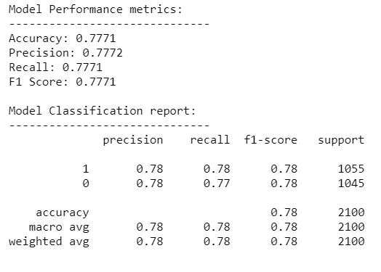
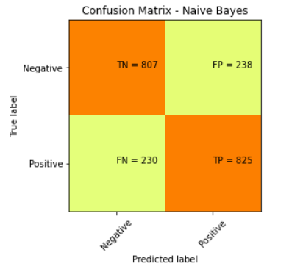
Baseline Model: Naïve Bayes

Slide 7
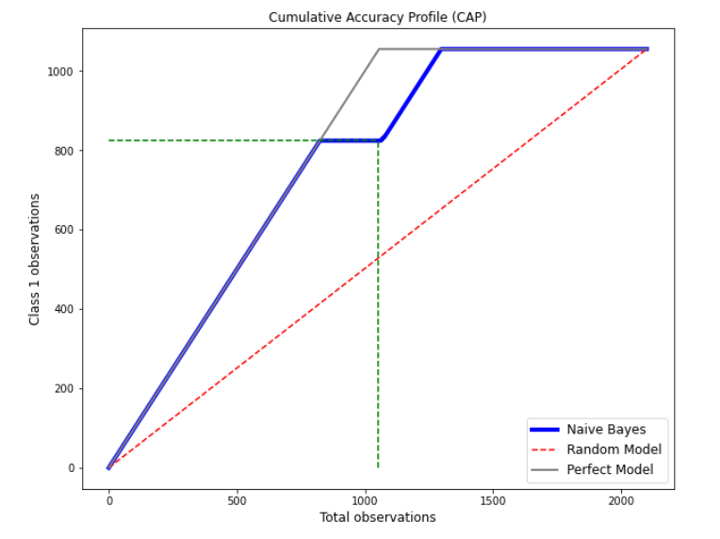
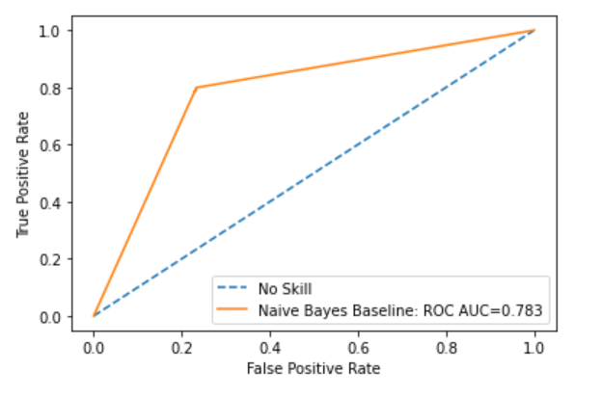
Baseline Model: Naïve Bayes (cont.)
78%
50%
Guidelines for Model:
X > 90% Overfitting
80% < X < 90% Very Good Model
70% < X < 80% Good Model
60% < X < 70% Average Model
X < 60% Poor Model
Accuracy ratio (AUNB/AUP): 0.898
Evaluate the Model using the 50% line on the CAP curve:
Value at the 50% line is 78% which suggests that the Naïve Bayes model is good
AUP = Area under the perfect model
AUNB = Area under the Naïve Bayes model

Slide 8
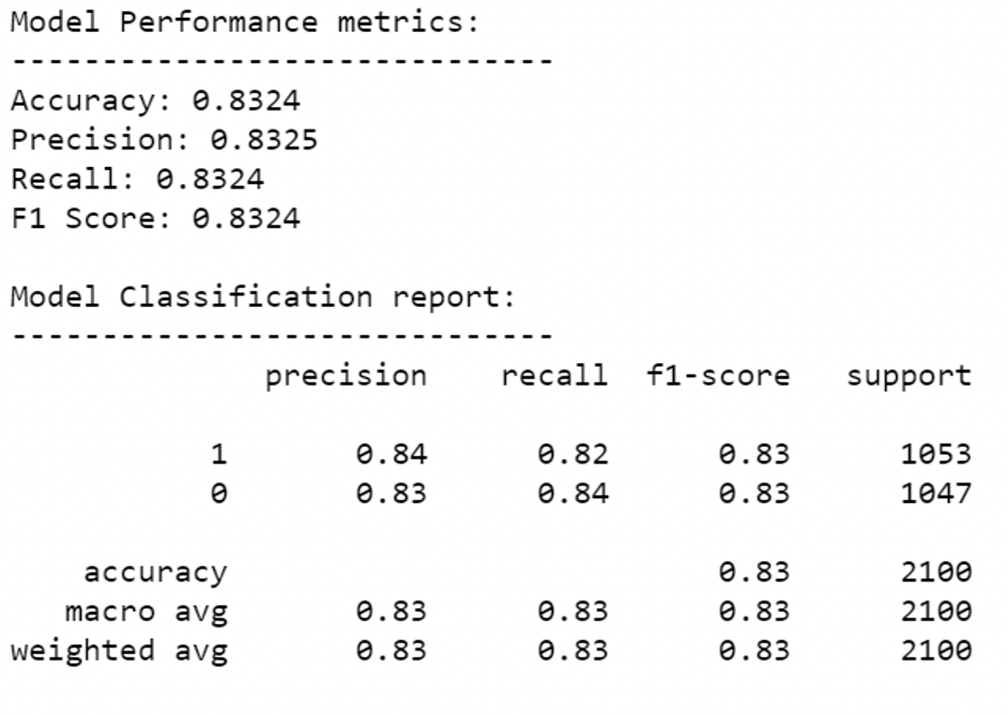
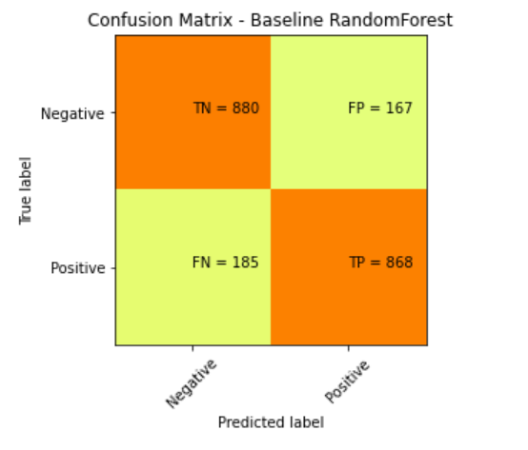
Baseline Model: Random Forest

Slide 9
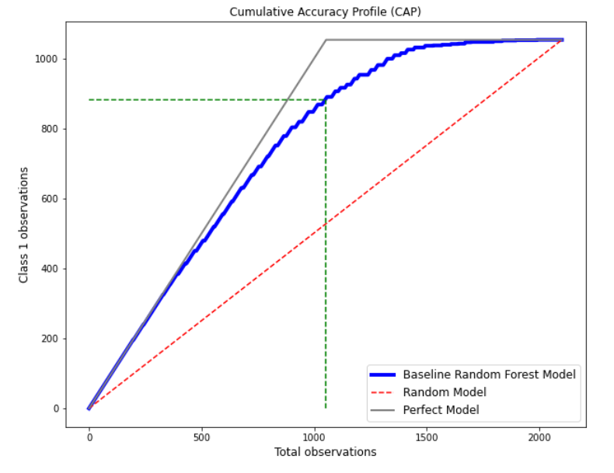
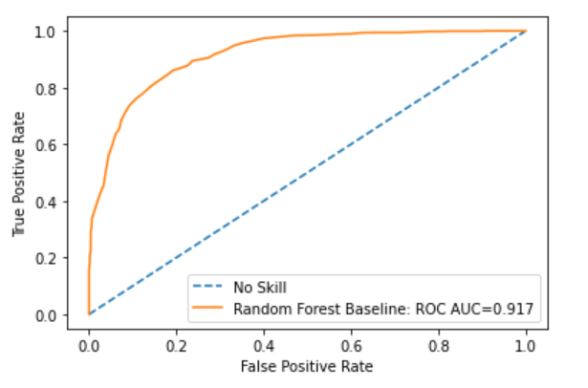
Baseline Model: Random Forest (cont.)
83%
50%
Guidelines for Model:
X > 90% Overfitting
80% < X < 90% Very Good Model
70% < X < 80% Good Model
60% < X < 70% Average Model
X < 60% Poor Model
Accuracy ratio (AURF/AUP): 0.841
Evaluate the Model using the 50% line on the CAP curve:
Value at the 50% line is 83% which suggests that the Random Forest model is very good
AUP = Area under the perfect model
AURF = Area under the Random Forest Model

Slide 10
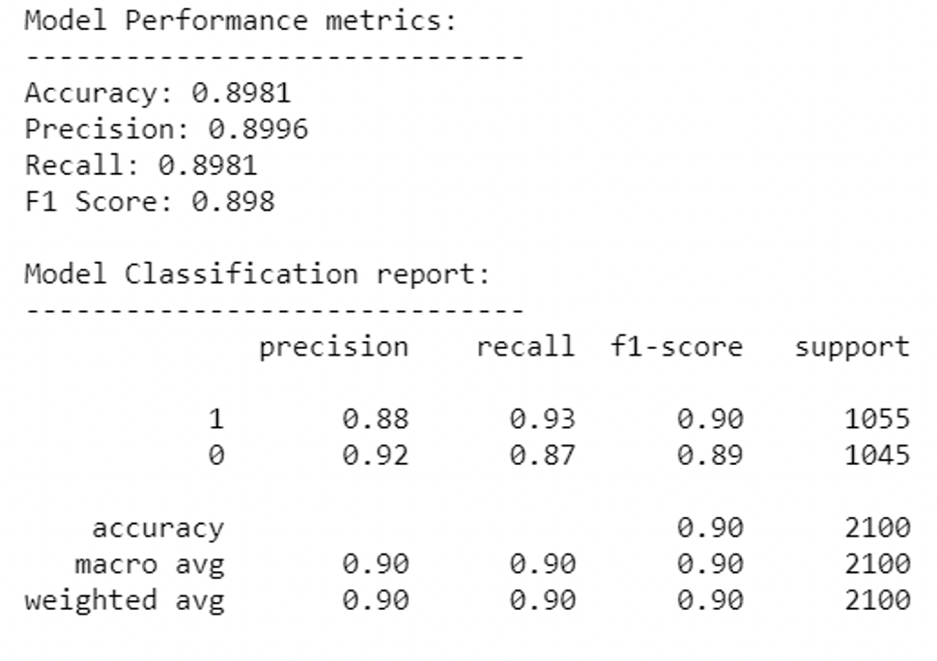
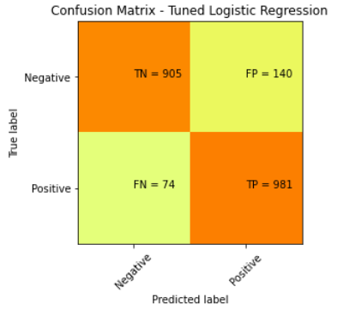
Hyperparameter tuning: Logistic Regression
Hyperparameter tuning was performed using python’s GridsearchCV function

Slide 11
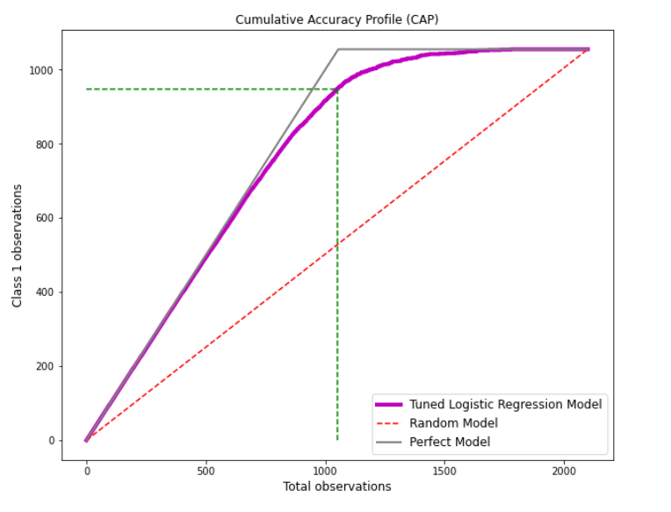
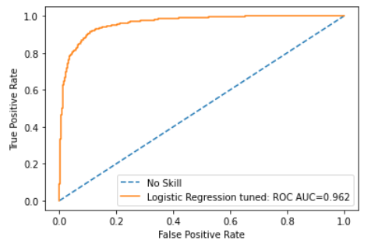
Hyperpar-ameter tuning: Logistic Regression
90%
50%
Guidelines for Model:
X > 90% Overfitting
80% < X < 90% Very Good Model
70% < X < 80% Good Model
60% < X < 70% Average Model
X < 60% Poor Model
Accuracy ratio (AUTLR/AUP): 0.924
Evaluate the Model using the 50% line on the CAP curve:
Value at the 50% line is 90% which suggests that the tuned Logistic Regression model is very good
AUP = Area under the perfect model
AUTLR = Area under the tuned Logistic Regression model

Slide 12
Hyperparameter tuning: Naïve Bayes
The Naïve Bayes model does not have any parameters which can be tuned therefore hyperparameter tuning was not conducted

Slide 13
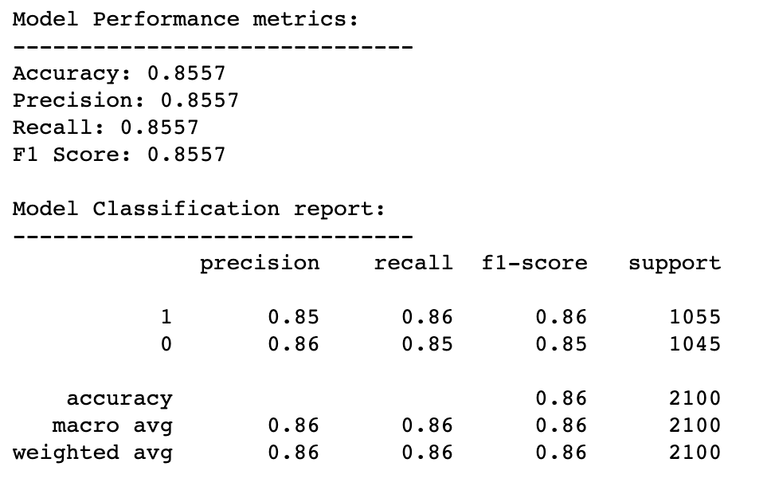
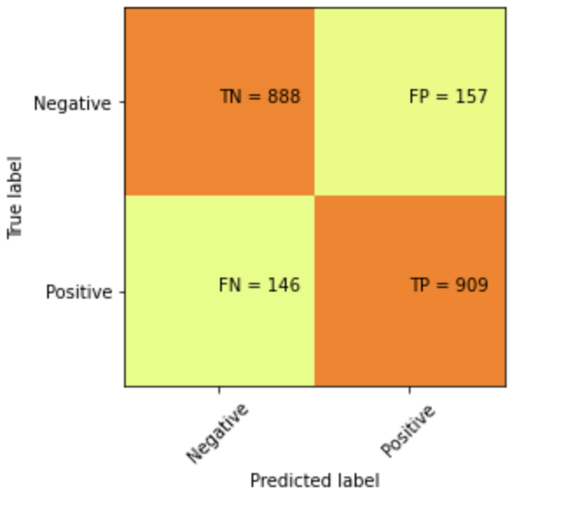
Hyperparameter tuning: Random Forest
Confusion matrix – Tuned RF
Hyperparameter tuning was performed using python’s RandomizedSearchCV function

Slide 14
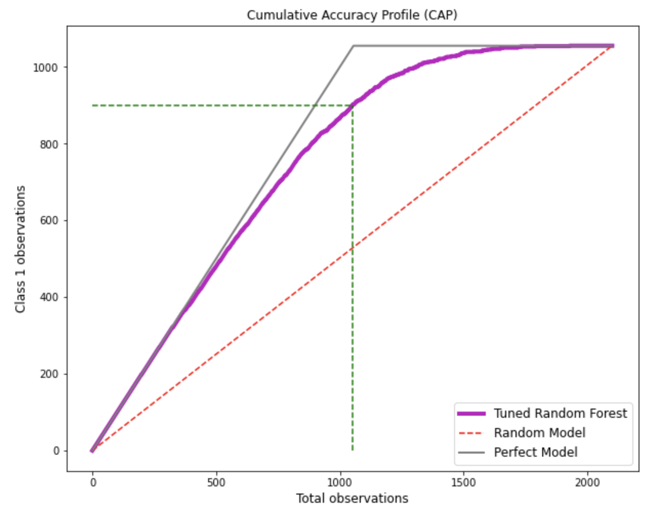
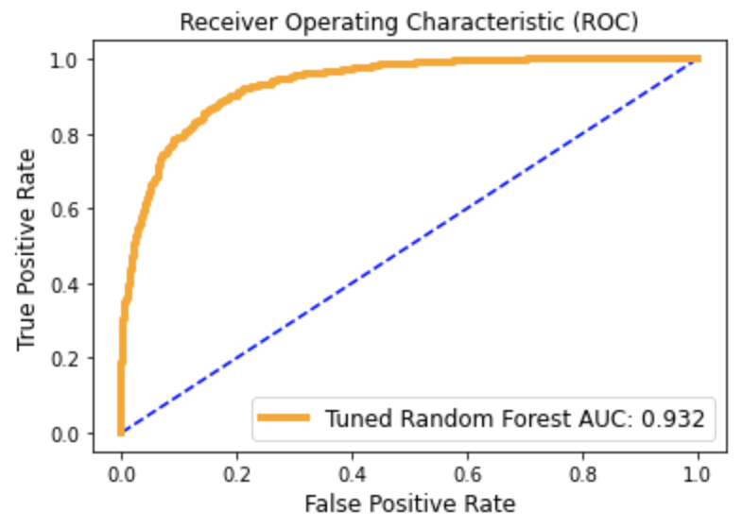
Hyperpar-ameter tuning: Random Forest
Guidelines for Model:
X > 90% Overfitting
80% < X < 90% Very Good Model
70% < X < 80% Good Model
60% < X < 70% Average Model
X < 60% Poor Model
Accuracy ratio (AUTLR/AUP): 0.864
Evaluate the Model using the 50% line on the CAP curve:
Value at the 50% line is 85.3% which suggests that the tuned Random Forest model is very good
AUP = Area under the perfect model
AUTLR = Area under the tuned Random Forest model

Slide 15
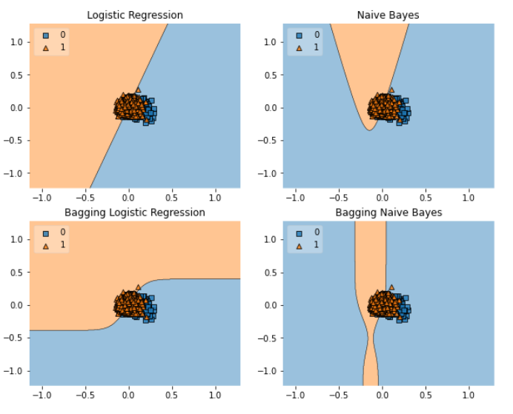
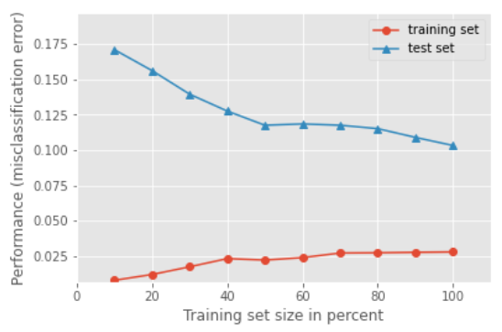
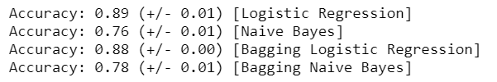
Ensemble Learning: Bagging
Bagging was implemented using the tuned logistic regression and Naïve Bayes models
Learning curve for Bagging LR classifier

Slide 16
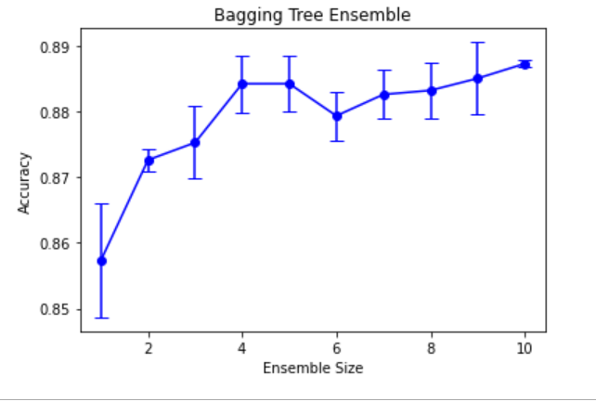
Ensemble Learning: Bagging (cont.)
Classifier Accuracy

Slide 17
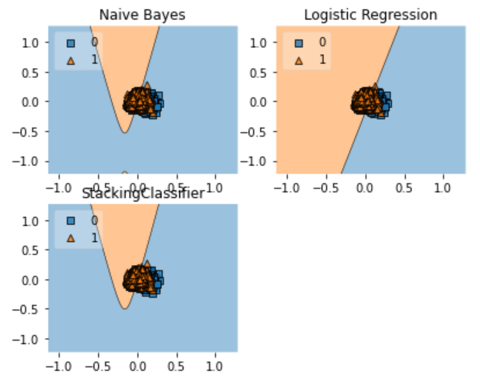
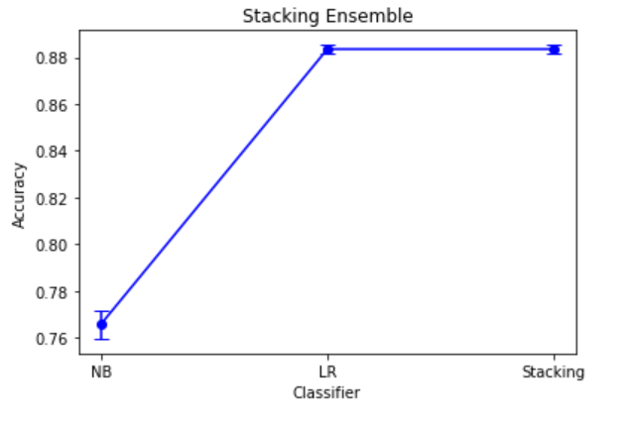

Ensemble Learning: Stacking
Stacking was implemented using the tuned logistic regression and Naïve Bayes models
Classifier Accuracy

Slide 18
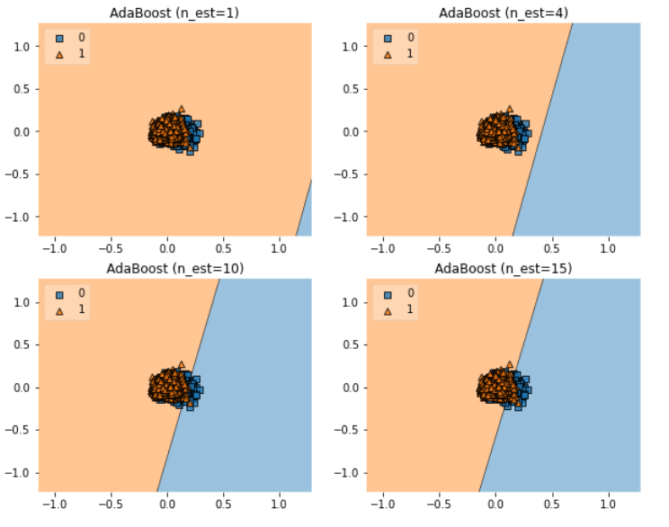
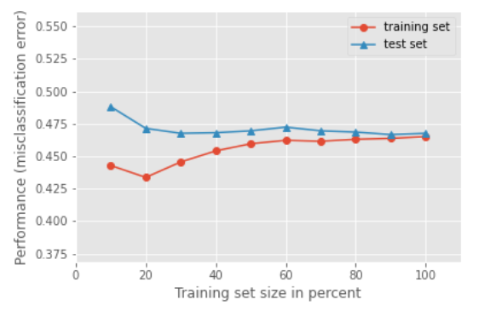
Ensemble Learning: Boosting
Boosting was implemented using AdaBoost. N_est = 10 and n_est = 15 seemed to perform best.
Learning Curve for n_est = 10

Slide 19
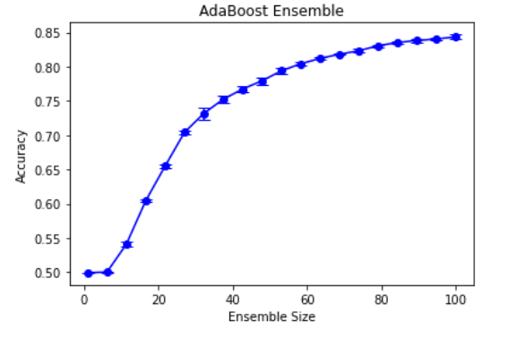
Ensemble Learning: Boosting (cont.)
Classifier Accuracy

Slide 20
Comparison of Results
Evaluation Metrics for all models
False Positive and False Negative for Logistic Regression and Naïve Bayes

Slide 21
Comparison of Results and Conclusions
The tuned Logistic Regression model had the best accuracy compared to the ensemble methods, the Naïve Bayes model and random forest model
The tuned Logistic Regression model’s accuracy was slightly better than the ensemble methods (+1%)
The ensemble methods runtimes were consistently an order of magnitude larger than that of the tuned Logistic Regression model.
Moving towards milestone 4, the tuned Logistic Regression model will be used, and feature engineering will be performed.

Slide 22

Thank you Questions?
https://blog.tcea.org/instructional-coaching-questions/

